Slide 1
Deaths – ONS Data – UPDATE
The Office for National Statistics (ONS) release weekly deaths broken down to local authority level, of all deaths and Covid-19 deaths. This dataset will be published every week and includes deaths outside of hospital.
Weekly deaths are provided for 2020 and from March 31 Covid-19 deaths relate to any death involving coronavirus (Covid-19), based on any mention of Covid-19 on the death certificate.
Two sets of tables are available, one set based on the date of registration and one set based on date of occurrence of death. There can be a time lag between a death taking place and the subsequent registration. The tables presented here include deaths that occurred up to 3rd July but were registered up to 11th July. This means there may be some revisions to the dataset for recent weeks, notably in relation to deaths by date of occurrence as registrations are subsequently made. These slides relate to date of occurrence not registration.
In the main data are provided at upper tier Local Authority level (given small numbers, at present, below this in terms of Covid-19), ONS release data at lower tier authority and where appropriate these figures are included.
Note: only deaths (whether Covid-19 or all cause) by place (setting of death) by local authority of usual residence are published on a weekly basis. We do not currently have weekly data on age, gender, or underlying condition at this geographical level.
However, age-standardised data on cumulative deaths occurring between 01/03/2020 and 31/05/2020 by sex at local level are presented here.
Mortality data for deaths occurring in hospitals are also available and these are published by hospital trust, with data being updated daily.
Jacqueline.clay@westsussex.gov.uk
0330 222 8684
Please call if you have queries about the data in the slides

Slide 2
Deaths – ONS Data – Overall Table – Deaths by Date of Occurrence
All cause deaths | Week ending
 | 3rd Jan | 10th Jan | 17th Jan | 24th Jan | 31st Jan | 7th Feb | 14th Feb | 21st Feb | 28th Feb | 6th Mar | 13th Mar | 20th Mar | 27th Mar | 3rd Apr | 10th Apr | 17th Apr | 24th Apr | 1st May | 8th May | 15th May | 22nd May | 29th May | 5th Jun | 12th Jun | 19th Jun | 26th Jun | 3rd Jul
Brighton and Hove | 45 | 42 | 39 | 42 | 40 | 36 | 33 | 38 | 37 | 56 | 32 | 38 | 60 | 63 | 63 | 72 | 61 | 39 | 53 | 45 | 35 | 41 | 25 | 26 | 40 | 45 | 23
East Sussex | 167 | 162 | 153 | 142 | 142 | 146 | 137 | 121 | 111 | 119 | 114 | 132 | 133 | 133 | 168 | 184 | 199 | 177 | 157 | 126 | 129 | 113 | 121 | 112 | 118 | 106 | 89
West Sussex | 214 | 215 | 186 | 197 | 202 | 184 | 197 | 206 | 196 | 203 | 179 | 187 | 203 | 243 | 306 | 309 | 322 | 278 | 215 | 220 | 203 | 170 | 149 | 160 | 148 | 156 | 128
Sussex areas combined | 426 | 419 | 378 | 381 | 384 | 366 | 367 | 365 | 344 | 378 | 325 | 357 | 396 | 439 | 537 | 565 | 582 | 494 | 425 | 391 | 367 | 324 | 295 | 298 | 306 | 307 | 240
Covid-19 | Week ending
 | 3rd Jan | 10th Jan | 17th Jan | 24th Jan | 31st Jan | 7th Feb | 14th Feb | 21st Feb | 28th Feb | 6th Mar | 13th Mar | 20th Mar | 27th Mar | 3rd Apr | 10th Apr | 17th Apr | 24th Apr | 1st May | 8th May | 15th May | 22nd May | 29th May | 5th Jun | 12th Jun | 19th Jun | 26th Jun | 3rd Jul
Brighton and Hove | - | - | - | - | - | - | - | - | - | - | - | 1 | 6 | 16 | 21 | 26 | 19 | 14 | 14 | 17 | 6 | 6 | 2 | 3 | 2 | 4 | 1
East Sussex | - | - | - | - | - | - | - | - | - | - | - | 2 | 10 | 22 | 41 | 47 | 53 | 36 | 40 | 33 | 29 | 14 | 9 | 5 | 7 | 4 | 6
West Sussex | - | - | - | - | - | - | - | - | - | - | - | 3 | 19 | 37 | 81 | 90 | 114 | 78 | 48 | 60 | 44 | 18 | 15 | 9 | 5 | 1 | 4
Sussex areas combined | - | - | - | - | - | - | - | - | - | - | - | 6 | 35 | 75 | 143 | 163 | 186 | 128 | 102 | 110 | 79 | 38 | 26 | 17 | 14 | 9 | 11
Non-Covid-19 | Week ending
 | 3rd Jan | 10th Jan | 17th Jan | 24th Jan | 31st Jan | 7th Feb | 14th Feb | 21st Feb | 28th Feb | 6th Mar | 13th Mar | 20th Mar | 27th Mar | 3rd Apr | 10th Apr | 17th Apr | 24th Apr | 1st May | 8th May | 15th May | 22nd May | 29th May | 5th Jun | 12th Jun | 19th Jun | 26th Jun | 3rd Jul
Brighton and Hove | 45 | 42 | 39 | 42 | 40 | 36 | 33 | 38 | 37 | 56 | 32 | 37 | 54 | 47 | 42 | 46 | 42 | 25 | 39 | 28 | 29 | 35 | 23 | 23 | 38 | 41 | 22
East Sussex | 167 | 162 | 153 | 142 | 142 | 146 | 137 | 121 | 111 | 119 | 114 | 130 | 123 | 111 | 127 | 137 | 146 | 141 | 117 | 93 | 100 | 99 | 112 | 107 | 111 | 102 | 83
West Sussex | 214 | 215 | 186 | 197 | 202 | 184 | 197 | 206 | 196 | 203 | 179 | 184 | 184 | 206 | 225 | 219 | 208 | 200 | 167 | 160 | 159 | 152 | 134 | 151 | 143 | 155 | 124
Sussex areas combined | 426 | 419 | 378 | 381 | 384 | 366 | 367 | 365 | 344 | 378 | 325 | 351 | 361 | 364 | 394 | 402 | 396 | 366 | 323 | 281 | 288 | 286 | 269 | 281 | 292 | 298 | 229

Slide 3
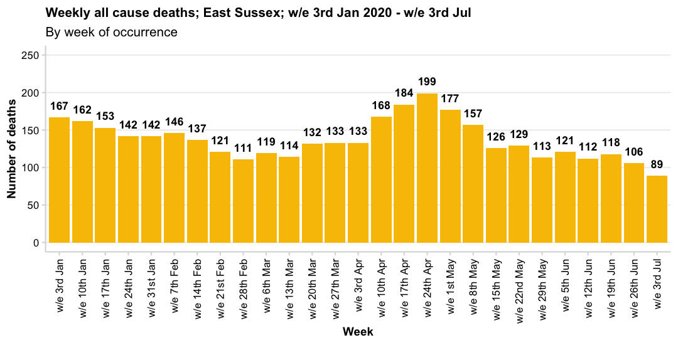
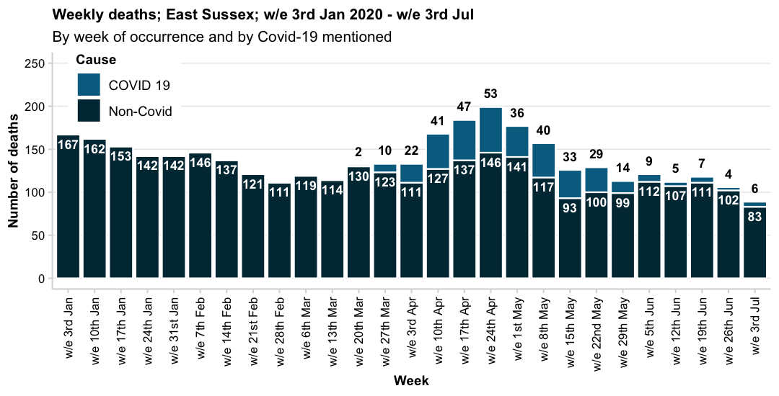
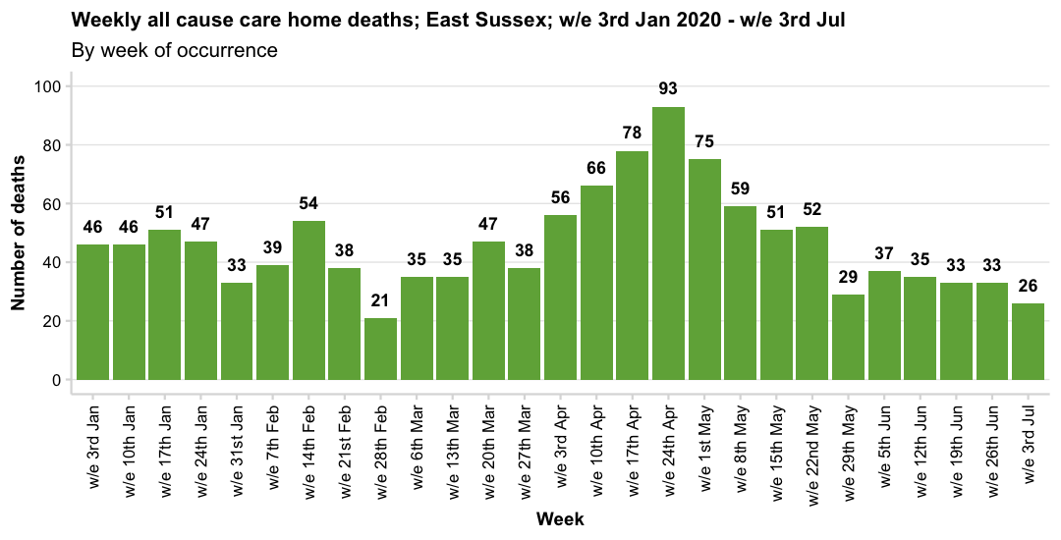
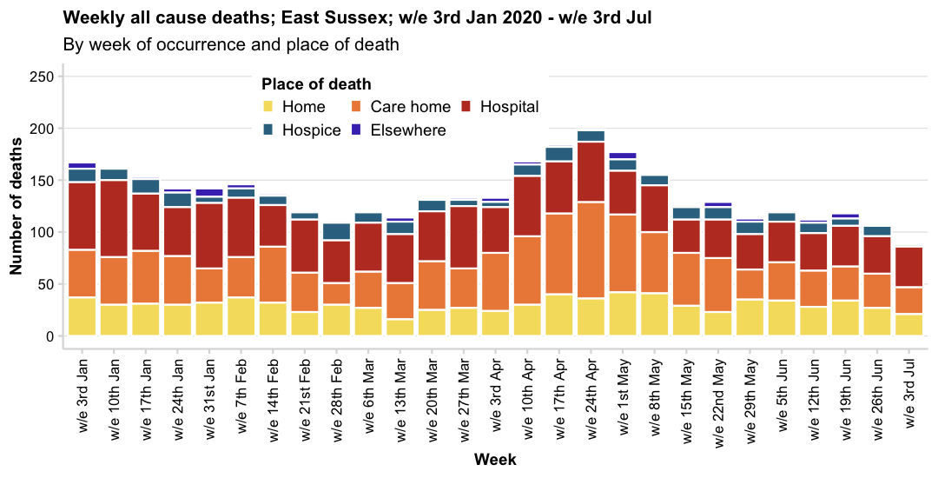
Source: Office for National Statistics

Slide 4
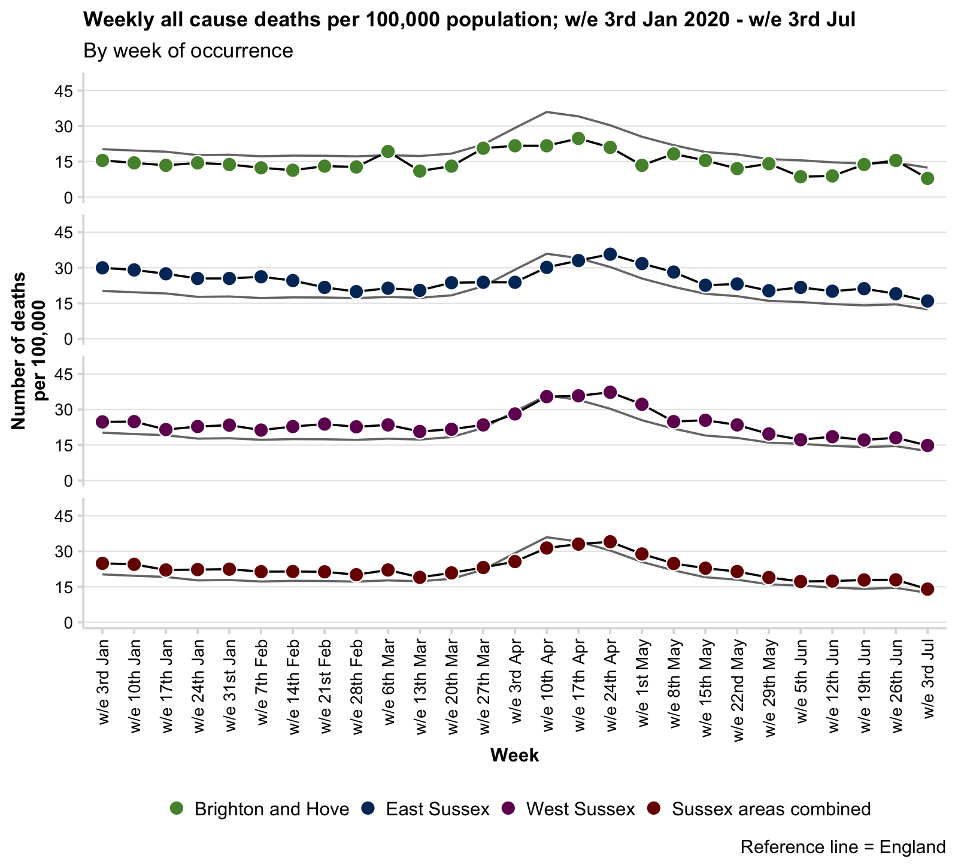
Crude rate of all cause mortality; to week ending 03/07/2020
Brighton and Hove
A crude rate is calculated using the mid-2018 population estimates (all ages) for each area. Note that some areas in Sussex, particularly West Sussex, have an older population compared with England and so the rate is usually, and expectedly, above the national rate.
The crude rate of death has risen considerably nationally and locally.
This increase started towards the end of March but appears to be declining in some areas.
This graph shows the considerable increase at a national level, so that local and national crude rates are similar.
An age/sex standardised rates are not currently available for the weekly ONS release, although cumulative data for a shorter time period are presented later in this slide deck.
East Sussex
West Sussex
Sussex areas combined

Slide 5
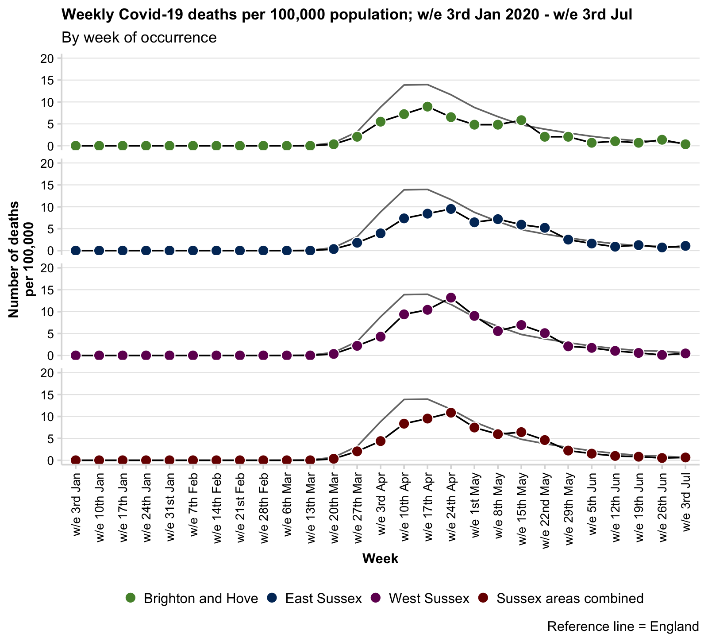
Crude rate of Covid-19 mortality; to week ending 03/07/2020
Crude rates of deaths where Covid-19 is mentioned as an underlying cause or contributing factor has risen locally.
In April the rate rose locally but was significantly lower than in England although rates are now statistically similar to national rates per 100,000 population.
The table below shows the change in deaths occurring in the last two weeks of reporting.
Note: the crude rate given in the table below is the cumulative total of Covid-19 deaths to date, and not the new deaths in the latest week.
Also note that deaths (particularly in the most recent week) may be revised if the were not registered by the 11th July.
Brighton and Hove
East Sussex
West Sussex
Sussex areas combined
Last two-week change Covid-19 mortality
Name | 26th Jun | 3rd Jul | Change (N) | Change (%) | Latest cumulative total | Latest cumulative rate per 100,000
Brighton and Hove | 4 | 1 | -3 | -75% | 158 | 54.3 (46.2-63.5)
East Sussex | 4 | 6 | 2 | 50% | 358 | 64.2 (57.8-71.3)
West Sussex | 1 | 4 | 3 | 300% | 626 | 72.5 (66.9-78.4)
Sussex areas combined | 9 | 11 | 2 | 22.2% | 1,142 | 66.7 (62.9-70.7)
England | 535 | 351 | -184 | -34.4% | 48,154 | 85.6 (84.8-86.3)

Slide 6
Areas are compared against their 15 statistical nearest neighbours. Ranks are therefore out of 16 with 1 being the highest and 16 being the lowest.
Statistical nearest neighbours are derived by The Chartered Institute of Public Finance and Accountancy (CIPFA) to group local authorities based on population characteristics, socioeconomic indicators, household and mortality characteristics.
Mortality summary tables; ONS death occurrence data; all deaths; week ending 03/07/2020
Name | All cause latest week summary | Covid-19 latest week summary | Proportion of deaths occurring in week that are attributed to Covid-19 | Rank of latest Covid-19 deaths crude rate among CIPFA neighbours | Total number of all cause deaths to date in 2020 | Rank of cumulative all cause deaths crude rate among CIPFA neighbours | Total number of deaths attributed to Covid-19 to date in 2020 | Rank of cumulative Covid-19 deaths crude rate among CIPFA neighbours | Proportion of deaths to date in 2020 attributed to Covid-19 | Rank of proportion of deaths to date attributed to Covid-19 among CIPFA neighbours
Brighton and Hove | 23 deaths (8 per 100,000, 95% CI: 5-12) | 1 death (0 per 100,000, 95% CI: 0-2) | 4.3% | 6th | 1,169 | 16th | 158 | 13th | 13.5% | 13th
East Sussex | 89 deaths (16 per 100,000, 95% CI: 13-20) | 6 deaths (1 per 100,000, 95% CI: 0-2) | 6.7% | 5th | 3,711 | 1st | 358 | 13th | 9.6% | 13th
West Sussex | 128 deaths (15 per 100,000, 95% CI: 12-18) | 4 deaths (0 per 100,000, 95% CI: 0-1) | 3.1% | 9th | 5,576 | 3rd | 626 | 12th | 11.2% | 13th
Mortality summary tables; ONS death occurrence data; deaths in care homes; week ending 03/07/2020
Name | All cause latest week care home summary | Covid-19 latest week care home summary | Proportion of care home deaths occurring in week that are attributed to Covid-19 | Rank of latest Covid-19 care home deaths crude rate among CIPFA neighbours per 1,000 care home beds | Total number of all cause care home deaths to date in 2020 | Total number of care home deaths attributed to Covid-19 to date in 2020 | Proportion of care home deaths to date in 2020 attributed to Covid-19 | Rank of cumulative all cause care home deaths crude rate among CIPFA neighbours | Rank of cumulative Covid-19 care home deaths crude rate among CIPFA neighbours per 1,000 care home beds | Rank of proportion of care home deaths to date attributed to Covid-19 among CIPFA neighbours
Brighton and Hove | 4 deaths (2 per 1,000 care home beds, 95% CI: 1-5) | 0 deaths (0 per 1,000 care home beds, 95% CI: 0-2) | 0% | 11th | 326 | 57 | 17.5% | 15th | 13th | 12th
East Sussex | 26 deaths (3 per 1,000 care home beds, 95% CI: 2-5) | 0 deaths (0 per 1,000 care home beds, 95% CI: 0-0) | 0% | 14th | 1,253 | 158 | 12.6% | 16th | 12th | 11th
West Sussex | 34 deaths (3 per 1,000 care home beds, 95% CI: 2-5) | 3 deaths (0 per 1,000 care home beds, 95% CI: 0-1) | 8.8% | 6th | 1,912 | 289 | 15.1% | 8th | 8th | 9th

Slide 7
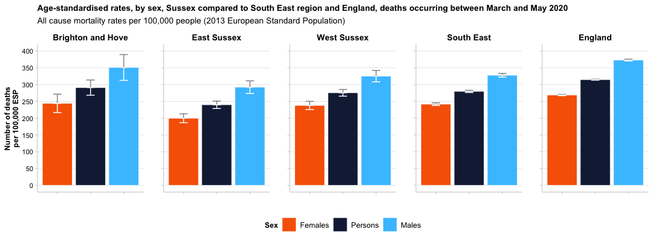
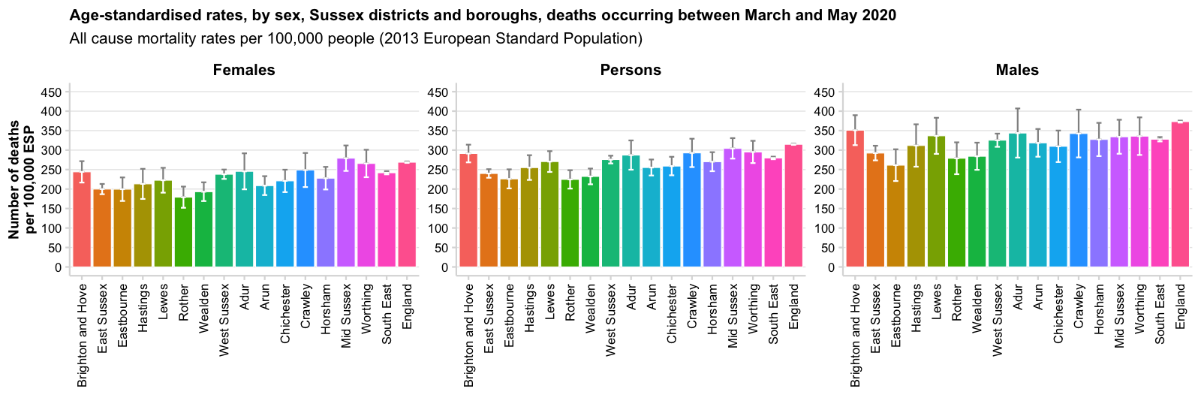
All cause mortality; persons; occurring 01/03/2020 – 31-05-2020
Name | All cause deaths | Age-standardised rate per 100,000
Brighton and Hove | 643 | 291 per 100,000 ESP, 95% CI: 268-314
East Sussex | 1,890 | 240 per 100,000 ESP, 95% CI: 229-251
Eastbourne | 348 | 226 per 100,000 ESP, 95% CI: 202-251
Hastings | 252 | 255 per 100,000 ESP, 95% CI: 223-287
Lewes | 405 | 271 per 100,000 ESP, 95% CI: 244-297
Rother | 369 | 225 per 100,000 ESP, 95% CI: 201-248
Wealden | 516 | 232 per 100,000 ESP, 95% CI: 212-253
West Sussex | 2,990 | 276 per 100,000 ESP, 95% CI: 266-286
Adur | 227 | 287 per 100,000 ESP, 95% CI: 250-325
Arun | 621 | 255 per 100,000 ESP, 95% CI: 235-276
Chichester | 471 | 259 per 100,000 ESP, 95% CI: 235-283
Crawley | 255 | 293 per 100,000 ESP, 95% CI: 256-329
Horsham | 475 | 270 per 100,000 ESP, 95% CI: 246-295
Mid Sussex | 519 | 304 per 100,000 ESP, 95% CI: 278-331
Worthing | 422 | 295 per 100,000 ESP, 95% CI: 267-324
South East | 27,021 | 280 per 100,000 ESP, 95% CI: 276-283
England | 170,194 | 315 per 100,000 ESP, 95% CI: 313-316
Differences in age-standardised rates of all cause mortality are generally only statistically significant at upper tier Local Authority level, with men consistently having a higher age-standardised mortality rate than women.

Slide 8
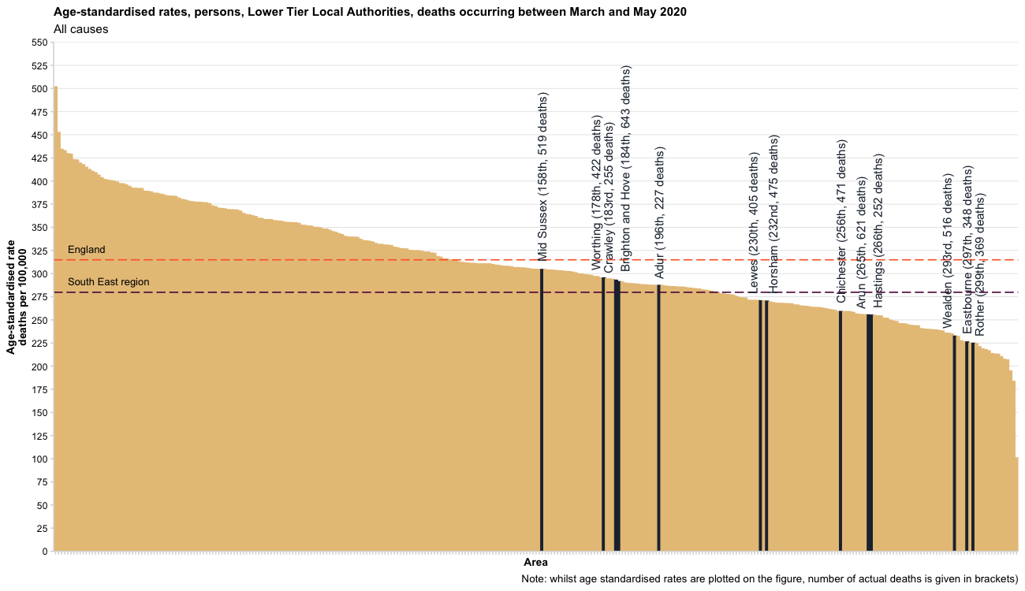
All cause mortality
Areas are ranked from highest to lowest age-standardised mortality rate out of 317 lower tier local authority areas (2019 boundaries).

Slide 9
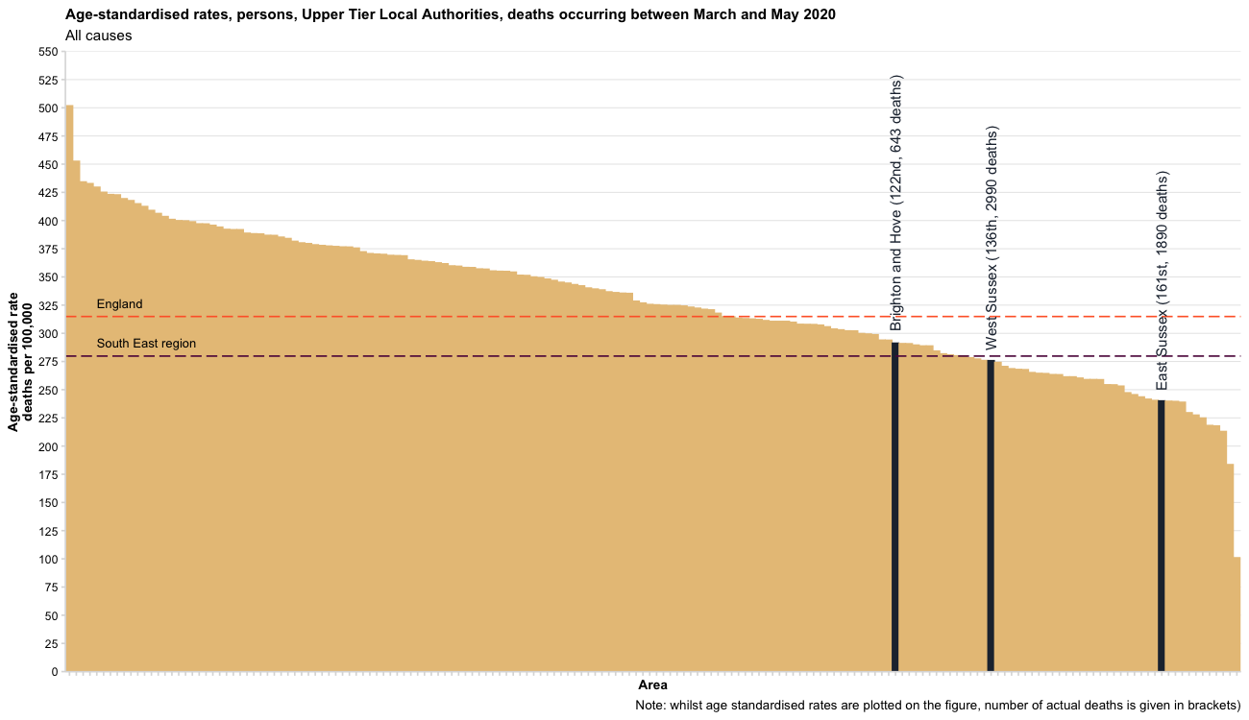
All cause mortality
Areas are ranked from highest to lowest age-standardised mortality rate out of 173 upper tier local authority areas (2019 boundaries).

Slide 10
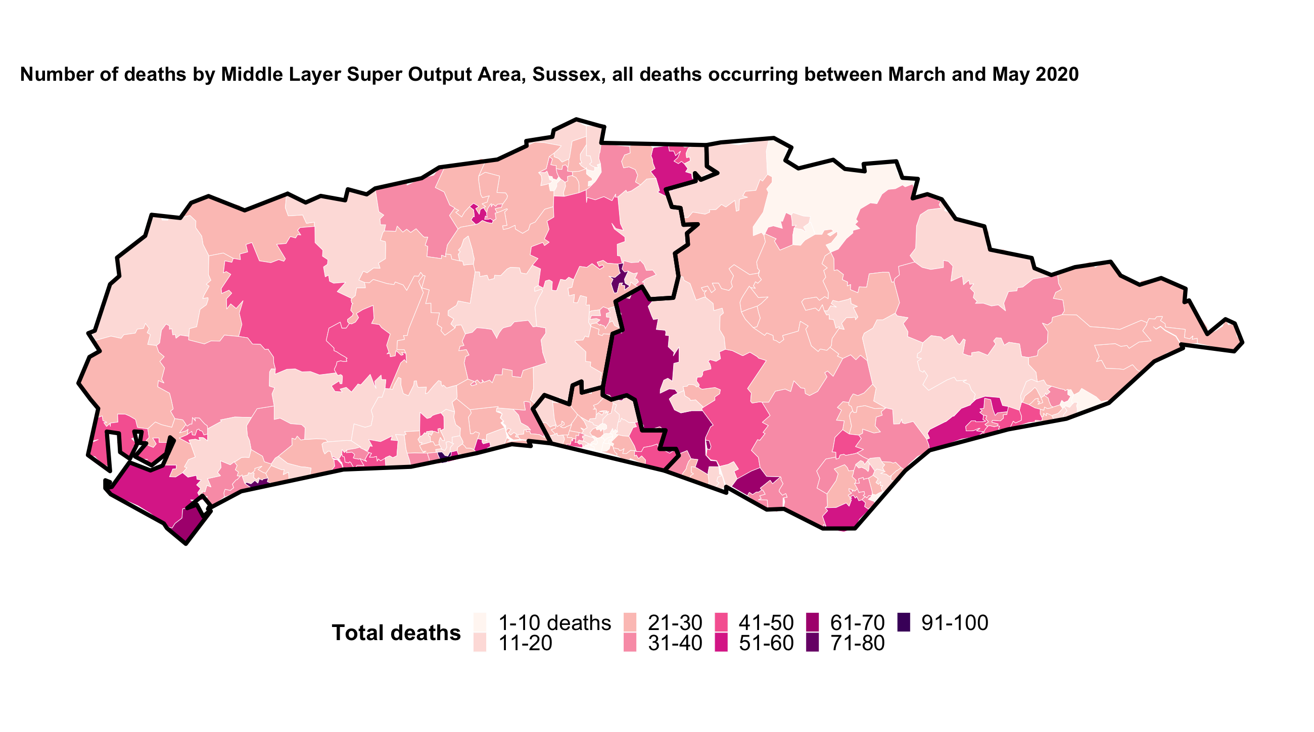
All cause mortality

Slide 11
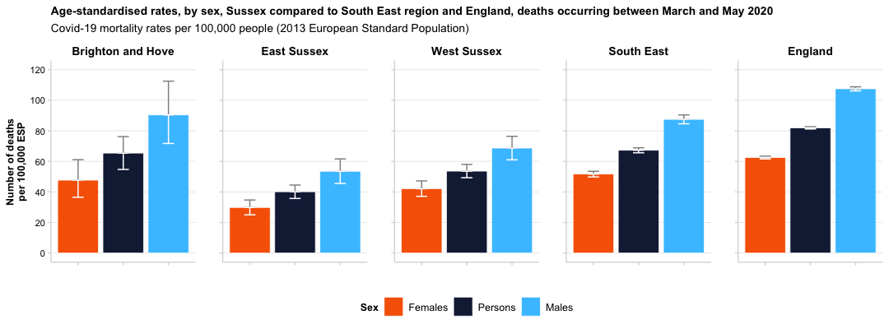
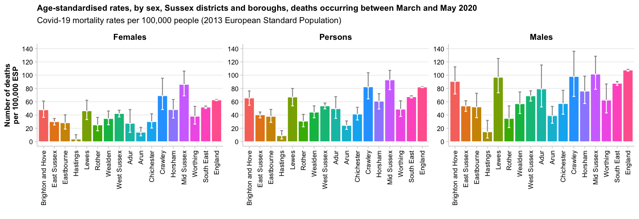
Covid-19 mortality; persons; occurring 01/03/2020 – 31/05/2020
Name | Covid-19 deaths | Age-standardised rate per 100,000
Brighton and Hove | 145 | 65 per 100,000 ESP, 95% CI: 55-76
East Sussex | 324 | 40 per 100,000 ESP, 95% CI: 36-44
Eastbourne | 64 | 38 per 100,000 ESP, 95% CI: 29-48
Hastings | 9 | 9 per 100,000 ESP, 95% CI: 4-16
Lewes | 103 | 67 per 100,000 ESP, 95% CI: 54-80
Rother | 49 | 31 per 100,000 ESP, 95% CI: 22-41
Wealden | 99 | 44 per 100,000 ESP, 95% CI: 36-54
West Sussex | 587 | 54 per 100,000 ESP, 95% CI: 49-58
Adur | 39 | 49 per 100,000 ESP, 95% CI: 35-68
Arun | 61 | 24 per 100,000 ESP, 95% CI: 18-31
Chichester | 77 | 41 per 100,000 ESP, 95% CI: 32-52
Crawley | 73 | 82 per 100,000 ESP, 95% CI: 64-104
Horsham | 107 | 61 per 100,000 ESP, 95% CI: 49-72
Mid Sussex | 159 | 93 per 100,000 ESP, 95% CI: 78-107
Worthing | 71 | 49 per 100,000 ESP, 95% CI: 38-61
South East | 6,511 | 67 per 100,000 ESP, 95% CI: 66-69
England | 44,359 | 82 per 100,000 ESP, 95% CI: 81-83
Age-standardised rates of Covid-19 mortality are higher among men compared with women.
Although numbers are small, there are some clear differences at lower tier local authority level, with Crawley, Mid Sussex, Brighton and Hove and Lewes having significantly higher rates of mortality compared with other areas.

Slide 12
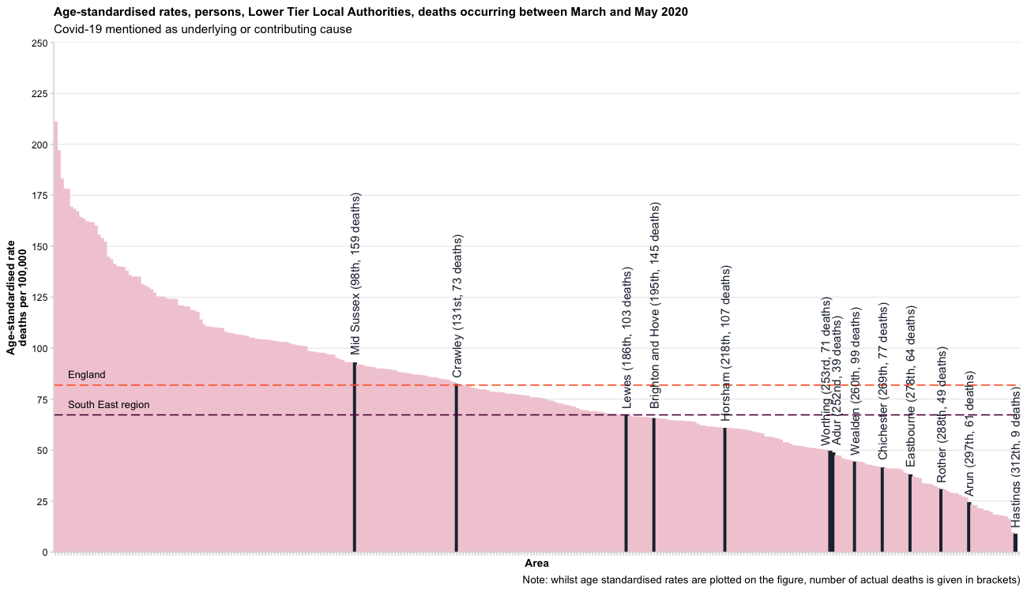
Covid-19 mortality
Areas are ranked from highest to lowest age-standardised mortality rate out of 317 lower tier local authority areas (2019 boundaries).

Slide 13
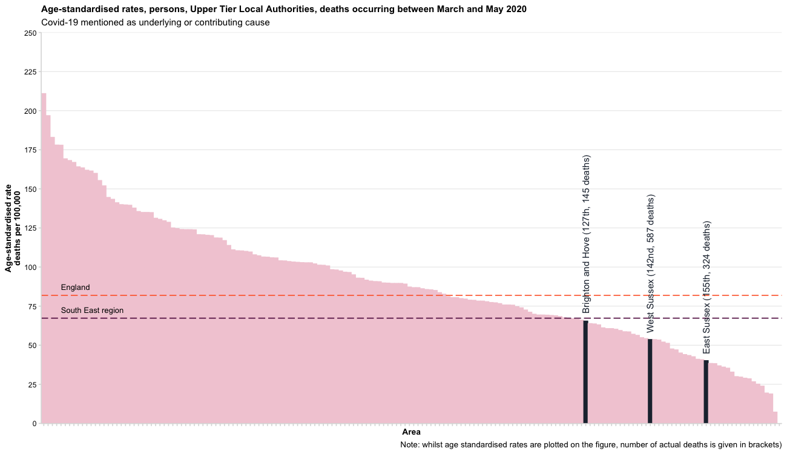
Covid-19 mortality
Areas are ranked from highest to lowest age-standardised mortality rate out of 173 upper tier local authority areas (2019 boundaries).

Slide 14
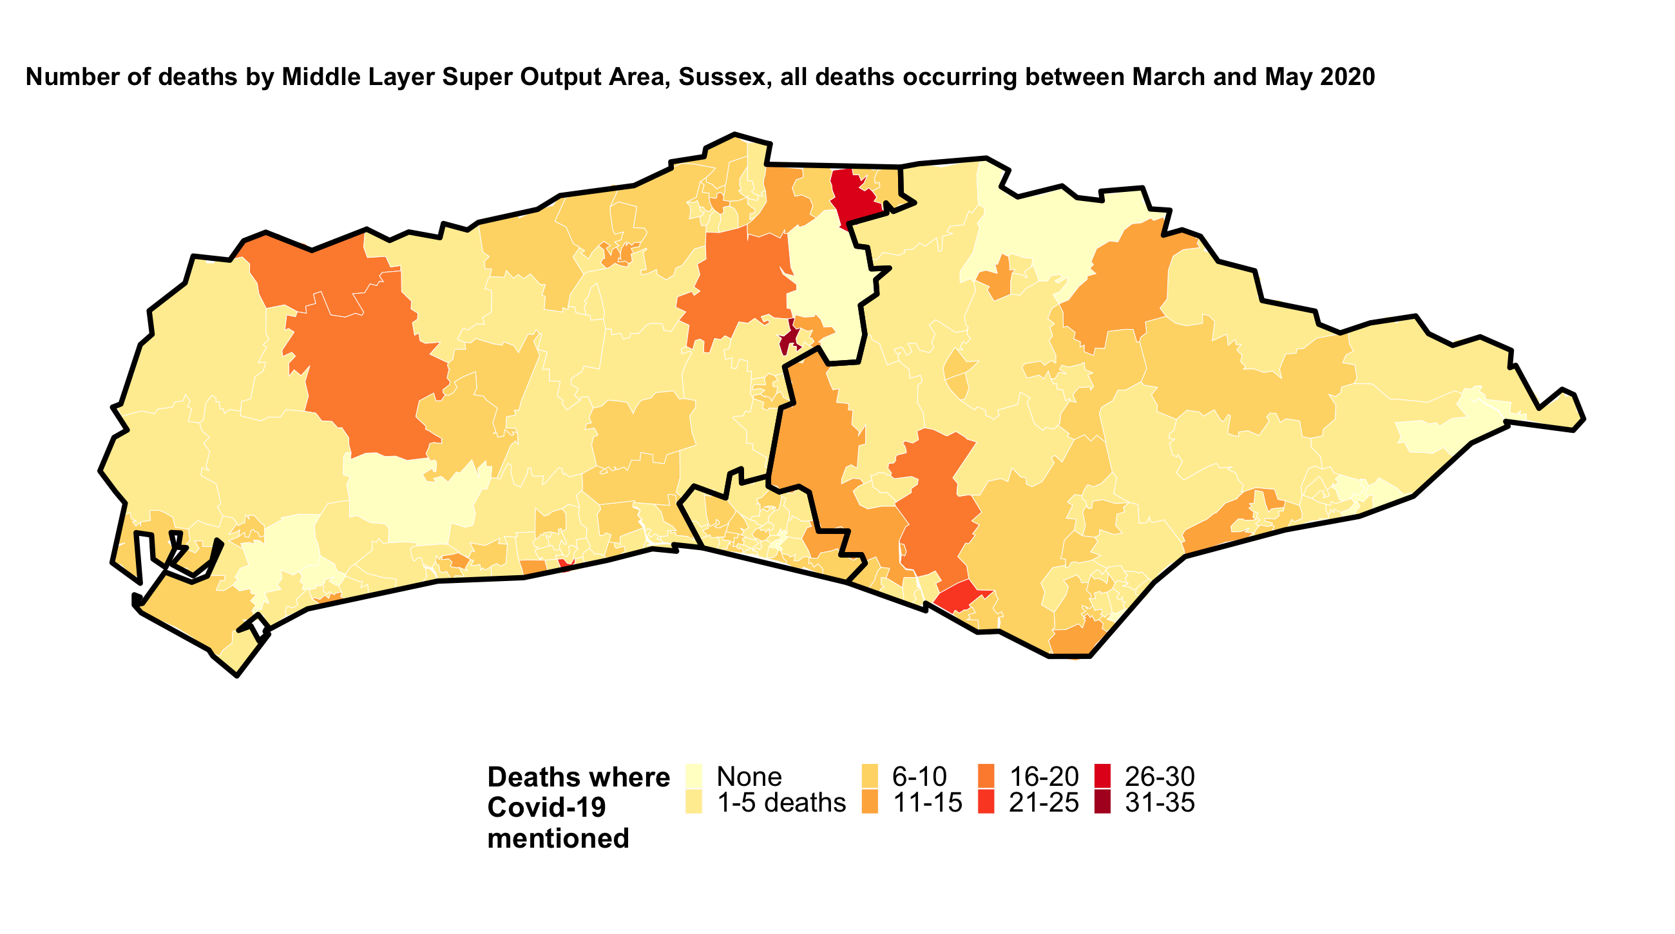
Covid-19 mortality

Slide 15
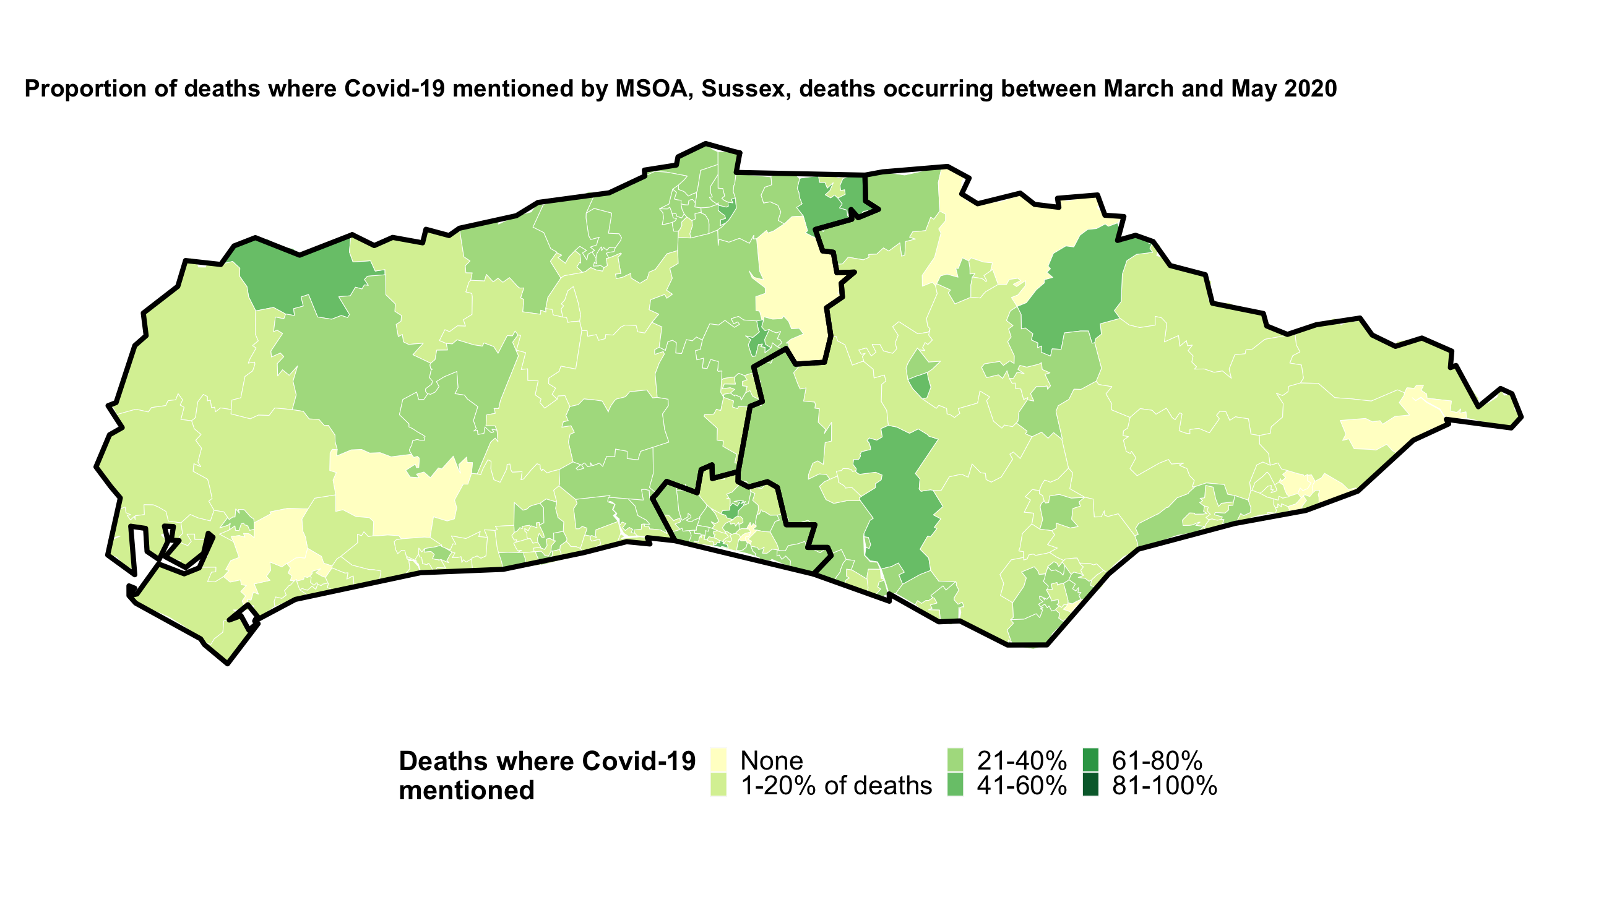
Covid-19 mortality

Slide 16
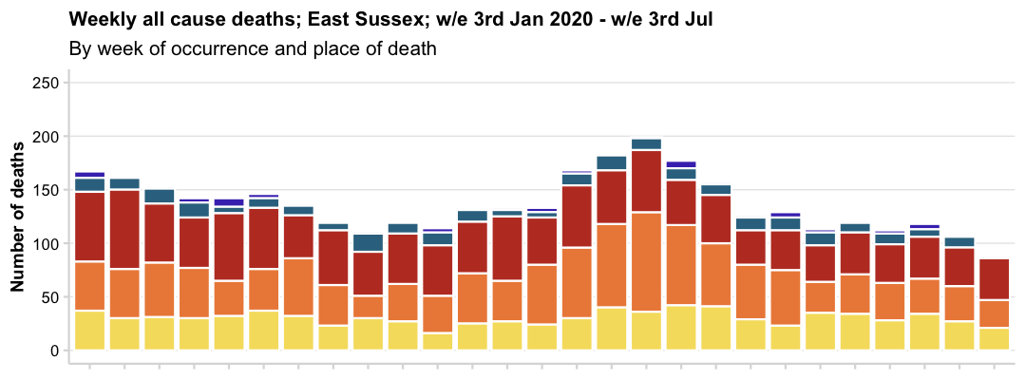
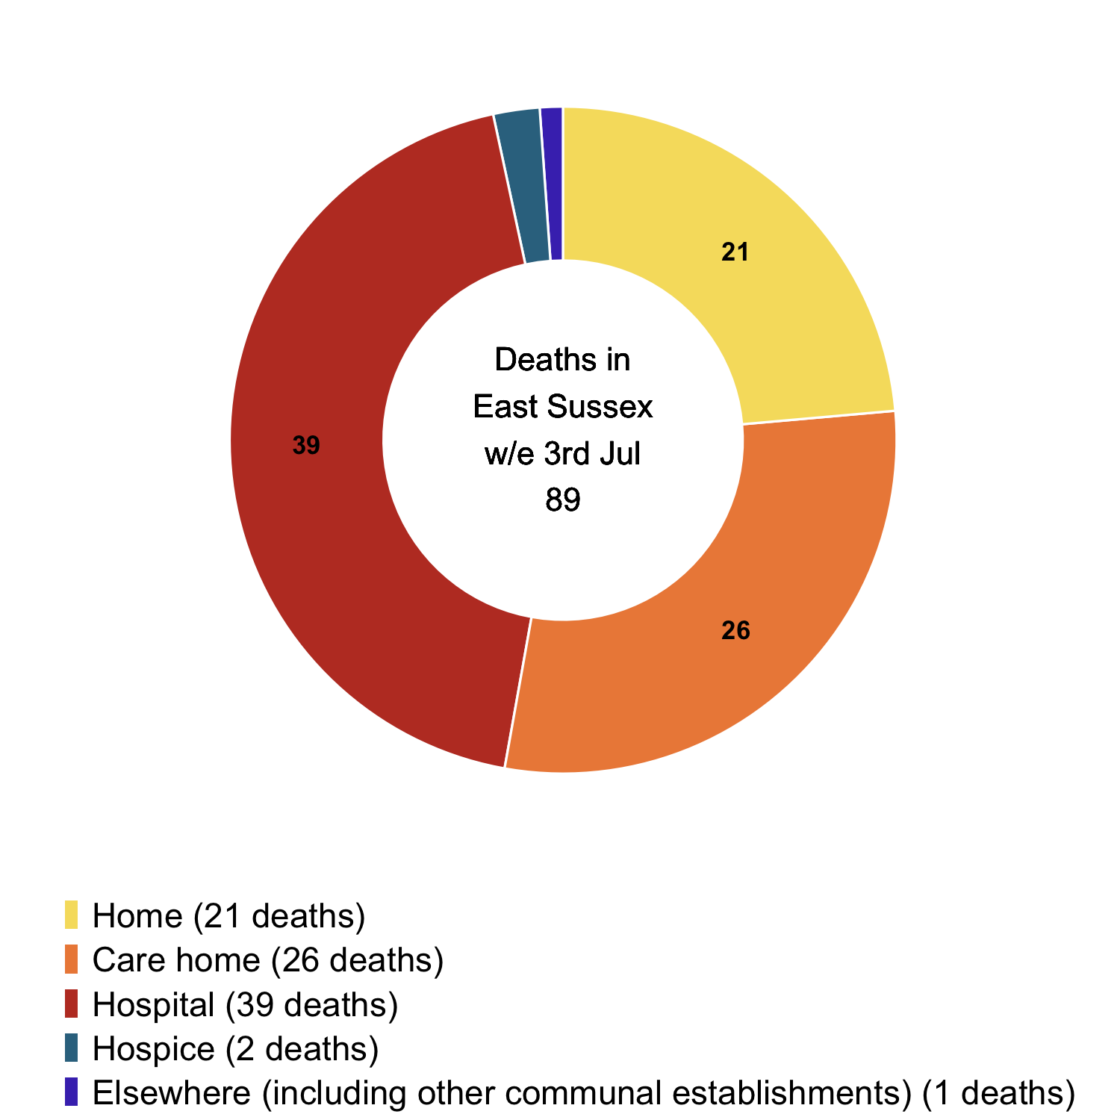
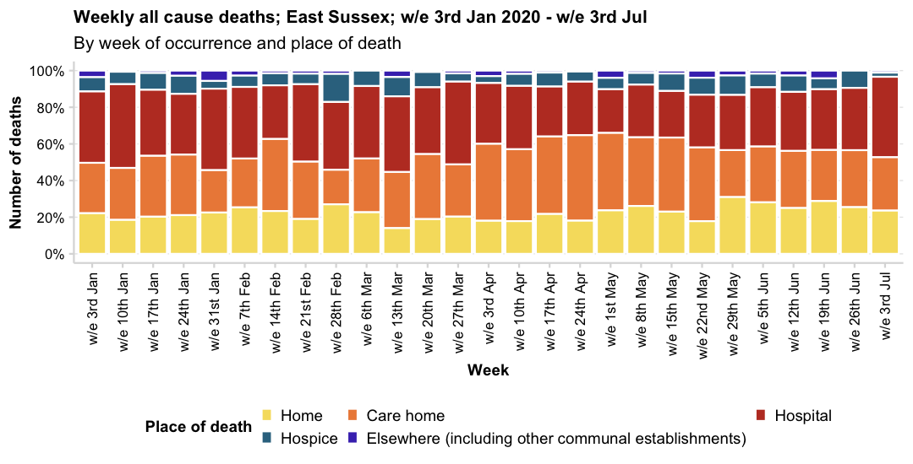
All cause mortality; East Sussex; week ending 3rd July
Place of death | 3rd Jan | 10th Jan | 17th Jan | 24th Jan | 31st Jan | 7th Feb | 14th Feb | 21st Feb | 28th Feb | 6th Mar | 13th Mar | 20th Mar | 27th Mar | 3rd Apr | 10th Apr | 17th Apr | 24th Apr | 1st May | 8th May | 15th May | 22nd May | 29th May | 5th Jun | 12th Jun | 19th Jun | 26th Jun | 3rd July
Home | 22.2% | 18.5% | 20.3% | 21.1% | 22.5% | 25.3% | 23.4% | 19.0% | 27.0% | 22.7% | 14.0% | 18.9% | 20.3% | 18.0% | 17.9% | 21.7% | 18.1% | 23.7% | 26.1% | 23.0% | 17.8% | 31.0% | 28.1% | 25.0% | 28.8% | 25.5% | 23.6%
Care home | 27.5% | 28.4% | 33.3% | 33.1% | 23.2% | 26.7% | 39.4% | 31.4% | 18.9% | 29.4% | 30.7% | 35.6% | 28.6% | 42.1% | 39.3% | 42.4% | 46.7% | 42.4% | 37.6% | 40.5% | 40.3% | 25.7% | 30.6% | 31.2% | 28.0% | 31.1% | 29.2%
Hospital | 38.9% | 45.7% | 35.9% | 33.1% | 44.4% | 39.0% | 29.2% | 42.1% | 36.9% | 39.5% | 41.2% | 36.4% | 45.1% | 33.1% | 34.5% | 27.2% | 29.1% | 23.7% | 28.7% | 25.4% | 28.7% | 30.1% | 32.2% | 32.1% | 33.1% | 34.0% | 43.8%
Hospice | 7.8% | 6.8% | 9.2% | 9.9% | 4.2% | 6.2% | 6.6% | 5.8% | 15.3% | 8.4% | 10.5% | 8.3% | 4.5% | 3.8% | 6.5% | 7.6% | 5.5% | 6.2% | 6.4% | 9.5% | 9.3% | 10.6% | 7.4% | 8.9% | 5.9% | 9.4% | 2.2%
Elsewhere | 3.6% | 0.6% | 1.3% | 2.8% | 5.6% | 2.7% | 1.5% | 1.7% | 1.8% | 0.0% | 3.5% | 0.8% | 1.5% | 3.0% | 1.8% | 1.1% | 0.5% | 4.0% | 1.3% | 1.6% | 3.9% | 2.7% | 1.7% | 2.7% | 4.2% | 0.0% | 1.1%

Slide 17
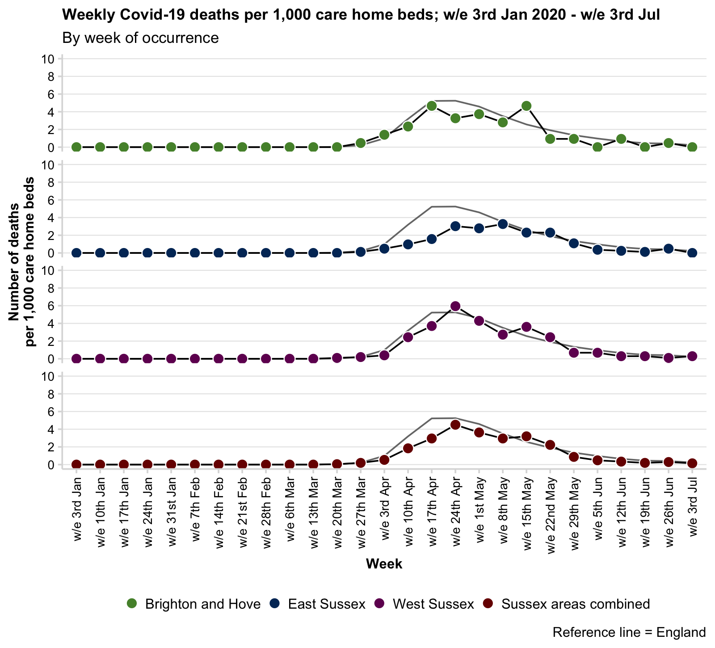
Crude rate of Covid-19 mortality in Care Homes; to week ending 03/07/2020
Crude rates of deaths where Covid-19 is mentioned as an underlying cause or contributing factor has risen locally.
The denominator is the number of beds in care homes (all; nursing and residential) in each area as reported by Care Quality Care (CQC) on the 31st of March 2019. The rate of Covid-19 deaths is given per 1,000 care home beds.
The table below shows the change in deaths occurring in the last two weeks of reporting.
Note: the crude rate given in the table below is the cumulative total of Covid-19 deaths to date, and not the new deaths in the latest week.
Also note that deaths (particularly in the most recent week) may be revised if the were not registered by the 11th July.
Brighton and Hove
East Sussex
West Sussex
Sussex areas combined
Last two-week change Covid-19 mortality in care homes
Name | 26th Jun | 3rd Jul | Change (N) | Change (%) | Latest cumulative total | Latest cumulative rate per 1,000 beds
Brighton and Hove | 1 | 0 | -1 | -100% | 57 | 26.6 (20.1-34.5)
East Sussex | 4 | 0 | -4 | -100% | 158 | 19.1 (16.3-22.4)
West Sussex | 1 | 3 | 2 | 200% | 289 | 28.2 (25-31.6)
Sussex areas combined | 6 | 3 | -3 | -50% | 504 | 24.4 (22.3-26.6)
England | 183 | 107 | -76 | -41.5% | 14,379 | 31.5 (31-32.1)

Slide 18
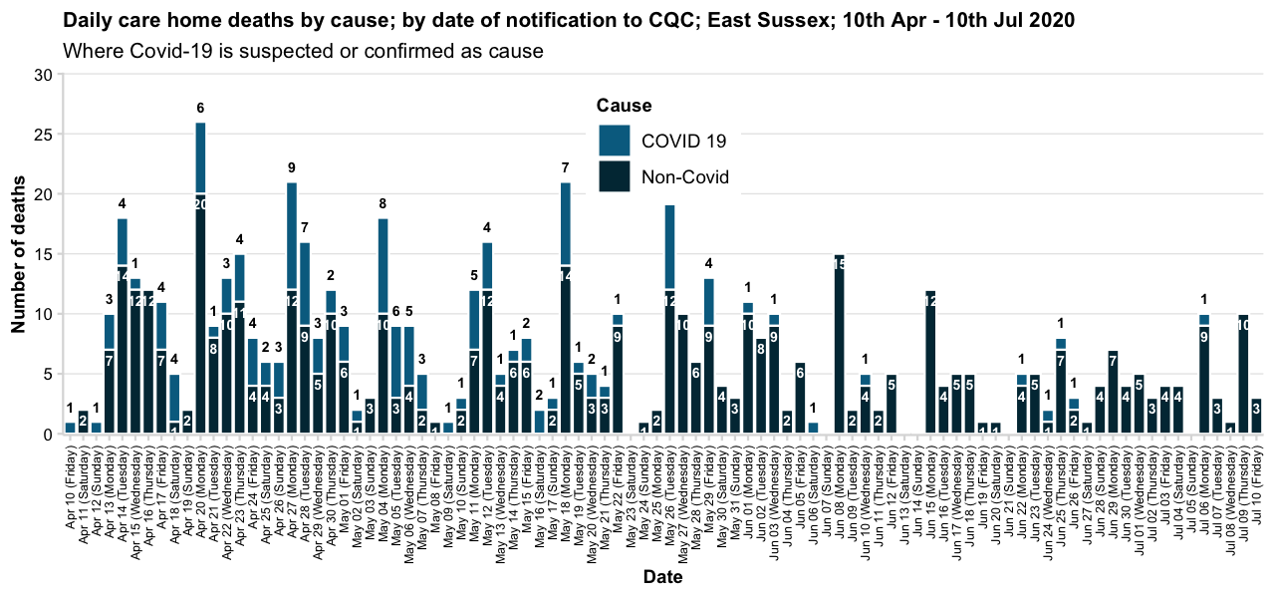
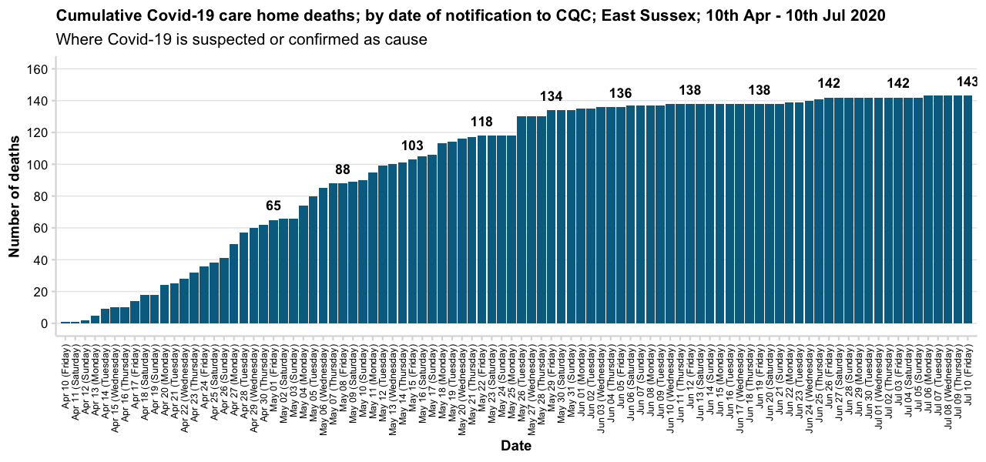
Daily care home deaths notified to the Care Quality Commission; East Sussex 10/07/2020
The processes for registering deaths naturally take time and so the Care Quality Commission, have begun reporting the number of deaths they have been notified as soon as it is practicably possible to support the response to Covid-19.
Death notifications by date of notification are provided weekly at the same time as the ONS release. Death notifications take on average 4 days to receive and process. These are not officially registered deaths and can be subject to revision and verification. Data are for April 10th onwards.
Note: Notifications only include those received by 5pm on 3rd July.
As at 10th July there have been 143 Covid-19 deaths notified to Care Quality Commission from East Sussex care homes.
This is 23.3% of the 614 deaths notified to CQC between 10th April and 10th July.

Slide 19
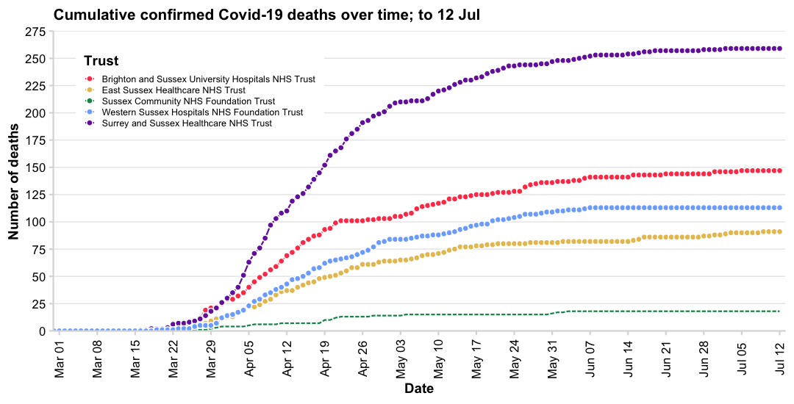
Daily hospital deaths notified to Department for Health and Social Care; up to 12/07/2020
This is the number of deaths of patients who have died in hospitals in England and had tested positive for Covid-19 at time of death. All deaths are recorded against the date of death rather than the day the deaths were announced.
These figures are updated at 2pm each day and include confirmed death cases reported at 5pm the previous day. The totals reported at 5pm on each day may not include all deaths that occurred on that day or on recent prior days due to operational pressures.
Data are provided daily by NHS Trusts and PHE Health protection teams to NHS England and only once confirmed family have been notified of the death.
Daily hospital deaths notified to Department for Health and Social Care; last 14 days to 12/07/2020
Trust | 29th Jun 2020 | 30th Jun 2020 | 1st Jul 2020 | 2nd Jul 2020 | 3rd Jul 2020 | 4th Jul 2020 | 5th Jul 2020 | 6th Jul 2020 | 7th Jul 2020 | 8th Jul 2020 | 9th Jul 2020 | 10th Jul 2020 | 11th Jul 2020 | 12th Jul 2020 | Total deaths reported in Trust so far | Crude rate deaths per 100,000 emergency catchment population
Brighton and Sussex University Hospitals NHS Trust | 0 | 2 | 0 | 0 | 0 | 0 | 1 | 0 | 0 | 0 | 0 | 0 | 0 | 0 | 147 | 27.4 per 100,000 (23.2-32.2)
East Sussex Healthcare NHS Trust | 0 | 1 | 0 | 1 | 1 | 0 | 0 | 0 | 0 | 0 | 1 | 0 | 0 | 0 | 91 | 24.9 per 100,000 (20.1-30.6)
Surrey and Sussex Healthcare NHS Trust | 0 | 0 | 0 | 1 | 0 | 0 | 0 | 0 | 0 | 0 | 0 | 0 | 0 | 0 | 259 | 67.7 per 100,000 (59.7-76.5)
Sussex Community NHS Foundation Trust | 0 | 0 | 0 | 0 | 0 | 0 | 0 | 0 | 0 | 0 | 0 | 0 | 0 | 0 | 18 | -
Western Sussex Hospitals NHS Foundation Trust | 0 | 0 | 0 | 0 | 0 | 0 | 0 | 0 | 0 | 0 | 0 | 0 | 0 | 0 | 113 | 23.7 per 100,000 (19.5-28.5)
England | 27 | 27 | 17 | 33 | 17 | 21 | 23 | 23 | 20 | 20 | 32 | 9 | 3 | 1 | 29,079 | -
These five days should be treated
as incomplete.

